Slide 1









A MULTI-AGENT RAG SYSTEM FOR LEGAL INFORMATION RETRIEVAL IN BANGLADESH
Presented by
MD. SIFAT HAQUE ZIDAN - 2212768042
ABDULLAH AL RAIYAN - 2212712042
RAHIL MEHNAZ - 2121843042

Slide 2
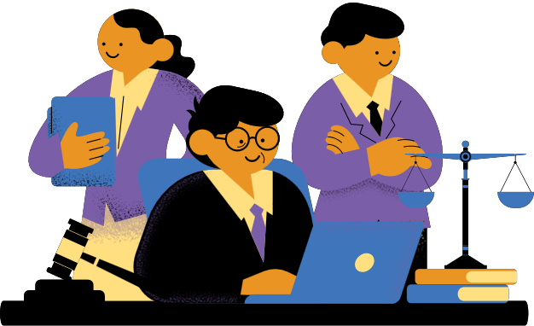

0UR PROJECT
  Multi-Agent RAG chatbot for Bangladeshi legal information
  Built using LangChain + LangGraph for reasoning
  Supports local (Ollama) deployment
  Legally accurate responses

Slide 3
MULTI-AGENT ARCHITECTURE (LANGGRAPH FRAMEWORK)
2-Agent architecture(built with LangChain):
  Clarification agent to check query clarity & ask follow-up questions
  RAG agent to retrieve from legal corpus
  Enables dynamic state transitions based on query quality

Slide 4

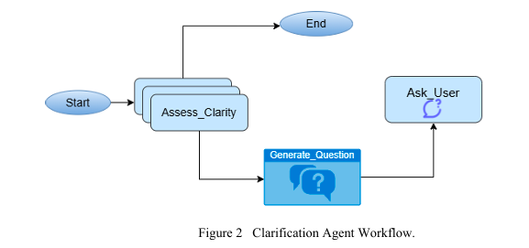
Clarification Agent
  Receive user query
  Assess clarity (assessment LLM)
  Generate clarifying question if vague
  Reassess refined input
  Forward to RAG Agent

Slide 5
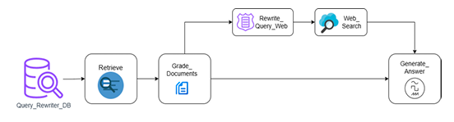
RAG AGENT
  Vector-based retrieval using ChromaDB
  Relevance grading using structured LLM
  Conditional web search via TavilySearchResults
  Answer synthesis (GPT-4o-mini / Gemma-3B) with factual grounding
RAG Agent Workflow

Slide 6
Query Rewriting
  Dedicated Rewriter LLM reformulates user input
  Retains intent, adds legal terminology, improves retrieval accuracy
Goal: Bridge the gap between natural and legal language.
For example, a user query like "How can I get a divorce?" may be rewritten as "What are the legal provisions for divorce under Bangladeshi family law?"

Slide 7
Conditional Web Search
  If corpus is sufficient → use internal data
  If not → trigger real-time web search (Tavily API)
  Implemented using should_search() in LangGraph

Slide 8
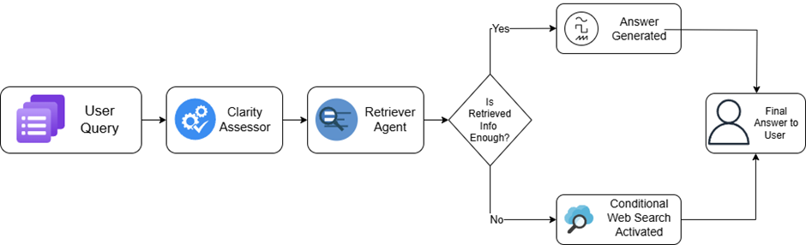
The Agents
  Detailed Agent Workflow

Slide 9
LLMs & Tools Used
Language Models:
  GPT-4o-mini ( reasoning & fluency)
  Gemma-3B (via Ollama) – local, private, cost-effective
LangChain Tools:
  retrieval_tool → vector search
  search_tool → real-time web retrieval
  answer_tool → structured legal response

Slide 10
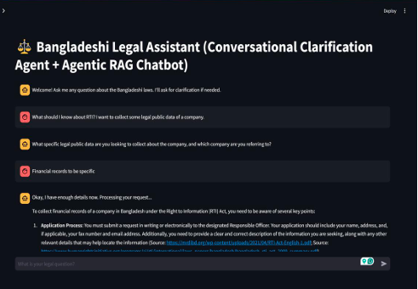
User Interface
  Built with Streamlit:
  Legal query input box
  Clarification dialogue section
  Final answer with references
  Supports both online and local use

Slide 11
Local deployment
Local models: Gemma-3B via Ollama
Advantages:
Low cost
Privacy preserving
Offline accessibility

Slide 12
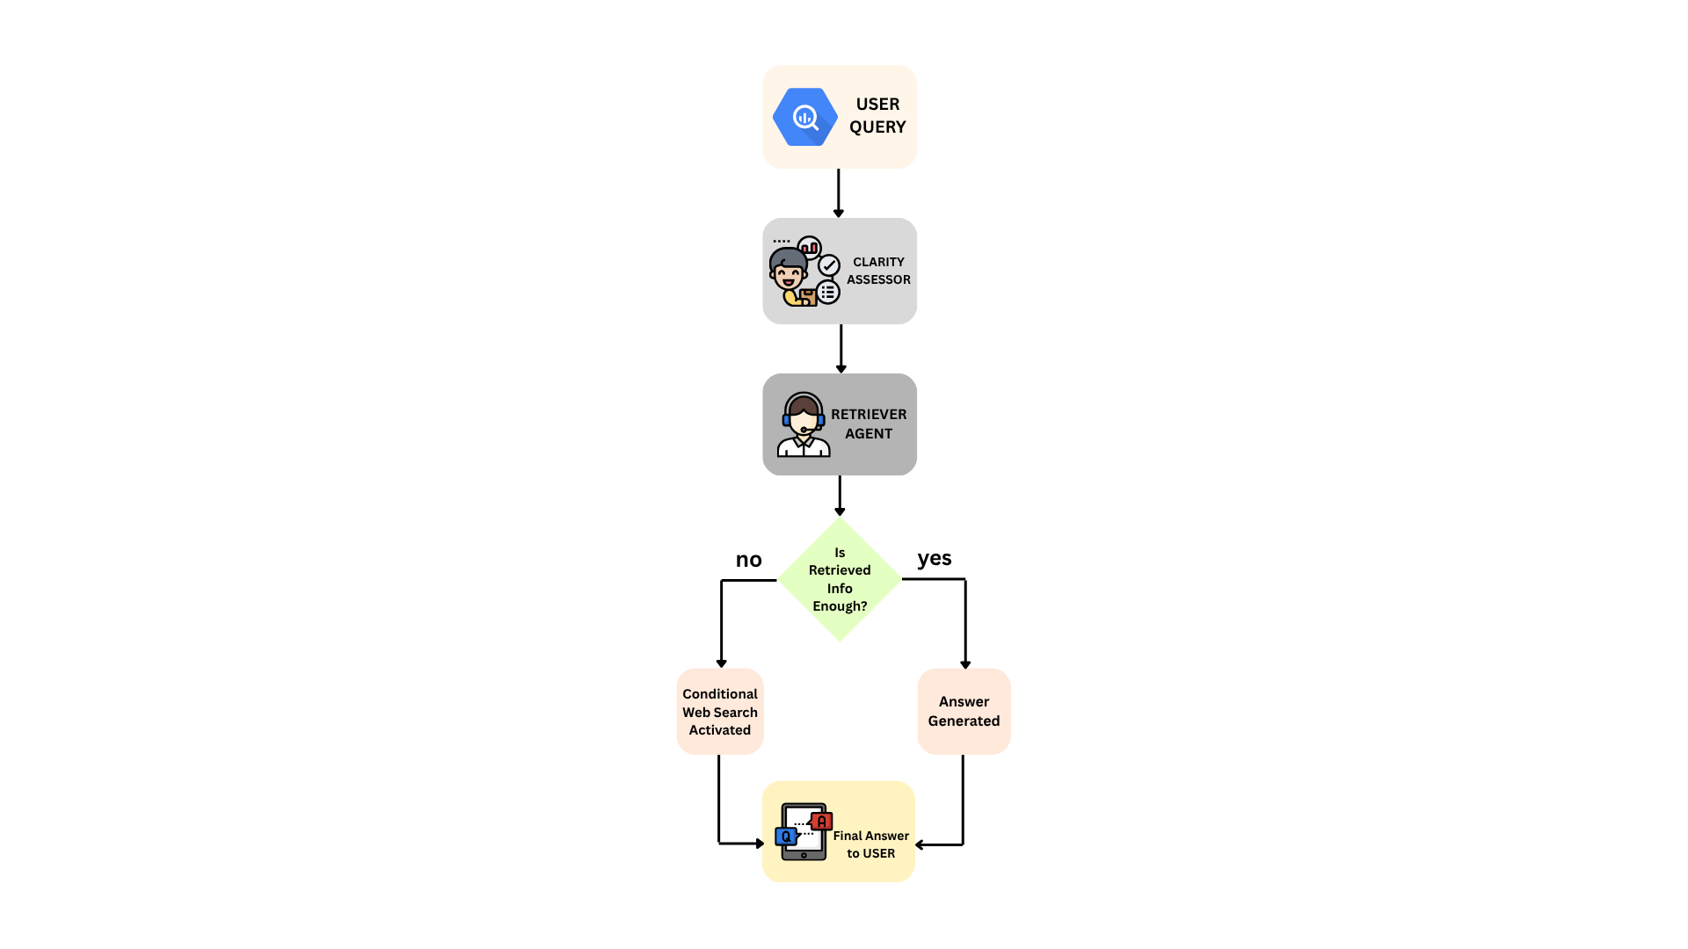




System Workflow
Query received by Clarification Agent
Relevant documents retrieved from vector DB
Conditional web search if corpus is insufficient
Final answer synthesized using retrieved context

Slide 13
Evaluation Pipeline
Automated Evaluation:
  LLM-as-a-Judge on 20 legal queries
  Metrics: Relevance, Faithfulness, Precision, Recall, Hallucination Score
Human Expert Review:
  2 Legal professionals rated responses
  Compared ChatGPT-4o vs RAG System
  Results: Higher legal correctness & contextual grounding

Slide 14
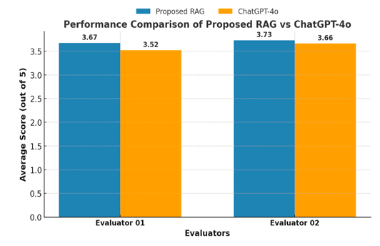
Comparison chart of GPT-4o vs RAG scores

Slide 15
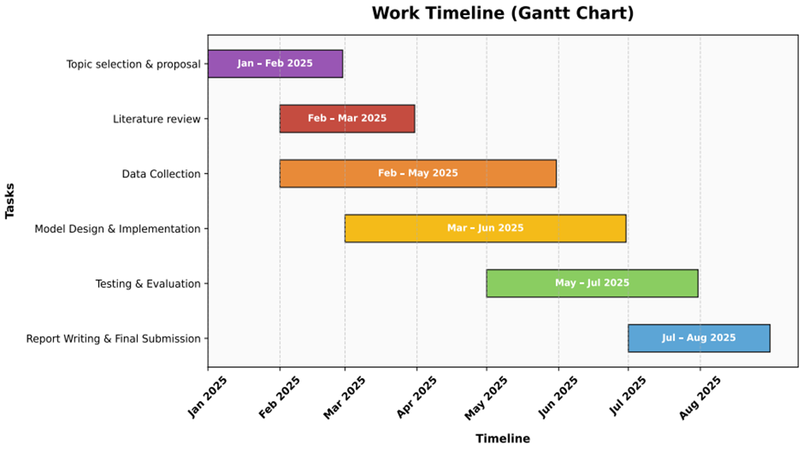
WORK TIMELINE (GANTT CHART)

Slide 16
SUMMARY OF KEY ACHIEVEMENTS
  Progressed from understanding basic RAG to building a sophisticated Multi-Agent system.
  Successfully customized RAG for the niche domain of Bangladeshi Law.
  Explored & implemented Agentic RAG concepts.
  Integrated advanced features: Conditional Web Search, Relevance Checking, and Clarification Questions.
  Developed a functional Streamlit UI for user interaction.
  Helps underserved populations access justice
  Cost effective

Slide 17
THANK
YOU

